Slide 1
Lesson 5
3NF Databases
T Myran

Slide 2
L5 - Syllabus Links
A3.2.6 Construct a database normalised to 3NF for a range of real-world scenarios
Examples may include library management, hospital management, e-commerce platforms, school management, employee management, inventory management, police crime reporting

Slide 3
Lesson 5 Creating 3NF Databases
Construct a database normalised to 3NF for a hospital management system

Slide 4
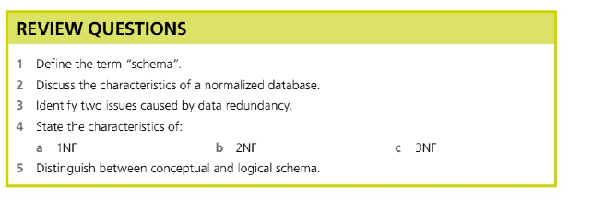
Recap of prior learning
Extension: Discuss the advantages and disadvantages of denormalising a database

Slide 5
Question 1 and 2
1. Define the term “schema”
A schema is the overall blueprint of a database that describes how data is organised, including tables, fields, data types, relationships, and constraints, but not the actual data itself.
2. Characteristics of a normalised database
A normalised database:
Minimises redundant (repeated) data by splitting data into related tables and using keys to link them.
Reduces update, insert, and delete anomalies, improving data integrity and consistency.
Ensures each table stores data about a single theme or entity, with attributes depending on the key, the whole key, and nothing but the key (up to 3NF).

Slide 6
3. Two issues caused by data redundancy
Any two of the following, each with brief explanation:
Data inconsistency: Different copies of the same data may not match if all occurrences are not updated correctly, reducing integrity and reliability.
Increased storage requirements: Storing the same data in multiple places wastes disk space.
Update anomalies / higher maintenance: Changes must be made in several places, increasing the chance of errors and making maintenance more complex.

Slide 7
4. Characteristics of 1NF, 2NF, 3NF
1NF (First Normal Form)
All attributes are atomic: each field contains a single, indivisible value (no repeating groups or lists in one cell).
Each record (row) is uniquely identifiable, usually by a primary key.
No repeating groups or repeated columns for the same kind of data.
2NF (Second Normal Form)
The table is already in 1NF.
Every non-key attribute is fully functionally dependent on the whole primary key (no partial dependency on part of a composite key).
3NF (Third Normal Form)
The table is already in 2NF.
There are no transitive dependencies: non-key attributes depend only on the primary key, not on other non-key attributes.

Slide 8
5. Conceptual vs logical schema
Conceptual schema: High-level view of the entire database showing entities, attributes, and relationships for the whole organisation; independent of any specific DBMS or physical storage details.​
Logical schema: More detailed, DBMS-oriented representation describing tables, fields, data types, primary and foreign keys, and constraints, typically designed following normalisation rules (often up to 3NF).​

Slide 9
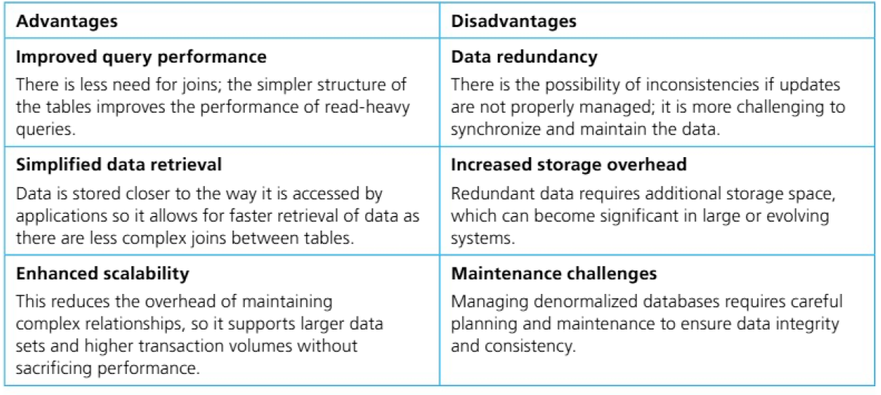
EXTENSION: Q6 Denomalisation

Slide 10
One significant advantage of denormalising a school database system is improved query performance for frequently accessed data. In a normalised database, retrieving a student's grades alongside their name and class details requires joining the Student table with the Grade table, which can be computationally expensive. However, in a denormalised structure where student information (StudentID, Name, Class) is stored directly within the Grade table, all required data can be retrieved from a single table without joins. This reduces query execution time for read-heavy operations such as generating report cards or class performance summaries. For school systems processing thousands of grade records daily, this performance improvement results in noticeably faster response times for teachers, administrators, and parent portals.
A major disadvantage of denormalisation is the introduction of data redundancy, which creates significant risks of data inconsistency. In a denormalised school database, if student details are duplicated across every grade record, a single student with 20 grade entries would have their personal information stored 20 times. When a student's information changes such as a name correction or class transfer must be applied to every row containing that student's data. If even one update is missed, the database will contain inconsistent information, violating data integrity principles. For academic records used in transcripts and university applications, such inconsistencies pose serious risks to data reliability. Additionally, redundant storage wastes space, which becomes increasingly costly as the school archives historical grade data. Denormalisation increases the complexity of database maintenance operations. Managing updates, insertions, and deletions becomes more difficult because changes must be synchronised across all locations where redundant data exists. This often requires additional application logic or database triggers to ensure consistency. For school IT staff with limited technical resources, this added complexity increases the likelihood of errors and requires more sophisticated programming skills.

Slide 11

Today’s Task
Work through the Hospital management Scenario in yor workbook
As an extension, complete the Logical Schema and SQL for the scenario
Challenge: complete one more scenario from scratch

Slide 12
Remember
First normal form (1NF)
Table has a primary key and no duplicate rows.
Every field is atomic: each cell holds a single, indivisible value (no lists like “Maths, English”).
No repeating groups or repeated columns for the same kind of data (e.g. Phone1, Phone2, Phone3).
In practice: split multi‑valued or repeating attributes into separate rows (and often separate tables).
Second normal form (2NF)
Focuses on tables with a composite primary key (key made of more than one column).
No partial dependency: every non‑key attribute must depend on the whole key, not just part of it.
In practice: if some columns depend only on one part of a composite key, move them to a new table where that part is the key.
Third normal form (3NF)
No transitive dependency: non‑key attributes must depend only on the key, not on other non‑key attributes.
Informal rule often used: “Every non‑key attribute depends on the key, the whole key, and nothing but the key.”
In practice: if a non‑key column can be derived from another non‑key column (e.g. City from Postcode), move it into a separate table with its own key.

Slide 13

Plenary:
⭐ Exit Ticket:
On a scale of 1-5, how confident are you?
1 □ 2 □ 3 □ 4 □ 5 □
The table below has at least one normalisation problem. Identify it and state which normal form rule it breaks.
🚀 Extension ⭐⭐
Identify ALL normalisation violations in the table above. For each one, explain:
Which NF rule it breaks
Why it creates a data integrity problem
💡 Challenge ⭐⭐⭐
Redesign the table(s) to be fully in 3NF. Sketch the new table structures, underlining primary keys and marking foreign keys with (FK). Justify each table you create.

Slide 14
Answer Key
Add these to the slide's speaker notes:
Main: DiagnosisCodes is not atomic (multiple values in one cell) → violates 1NF; DoctorCity depends on the doctor, not BookingID → transitive dependency, violates 3NF
Extension: Two violations — 1NF (non-atomic DiagnosisCodes) + 3NF (transitive: BookingID → DoctorID → DoctorCity)
Challenge: Split into 3 tables: Booking(BookingID, PatientName, DoctorID), Doctor(DoctorID, DoctorCity), BookingDiagnosis(BookingID, DiagnosisCode)
This scenario deliberately uses a hospital context to mirror the lesson's main task, so it feels like a natural review rather than a disconnected activity. The three tiers let students self-differentiate: most will spot the 1NF issue quickly, while the challenge requires reconstructing full 3NF tables from scratch.​

